Slide 1

Capstone Project Approval
Project Title: Using Digital Twinning to enhance Human-Robot Collaboration with augmented reality
Project ID: PW23_AKP_02
Project Guide: Dr.Ashok Kumar Patil
Project Team: 2_7_158_237

Slide 2
Outline
Problem Statement
Scope and Feasibility study
Applications/Use cases
Expected Deliverables
Capstone (Phase-I & Phase-II) Project Timeline
Any other information

Slide 3
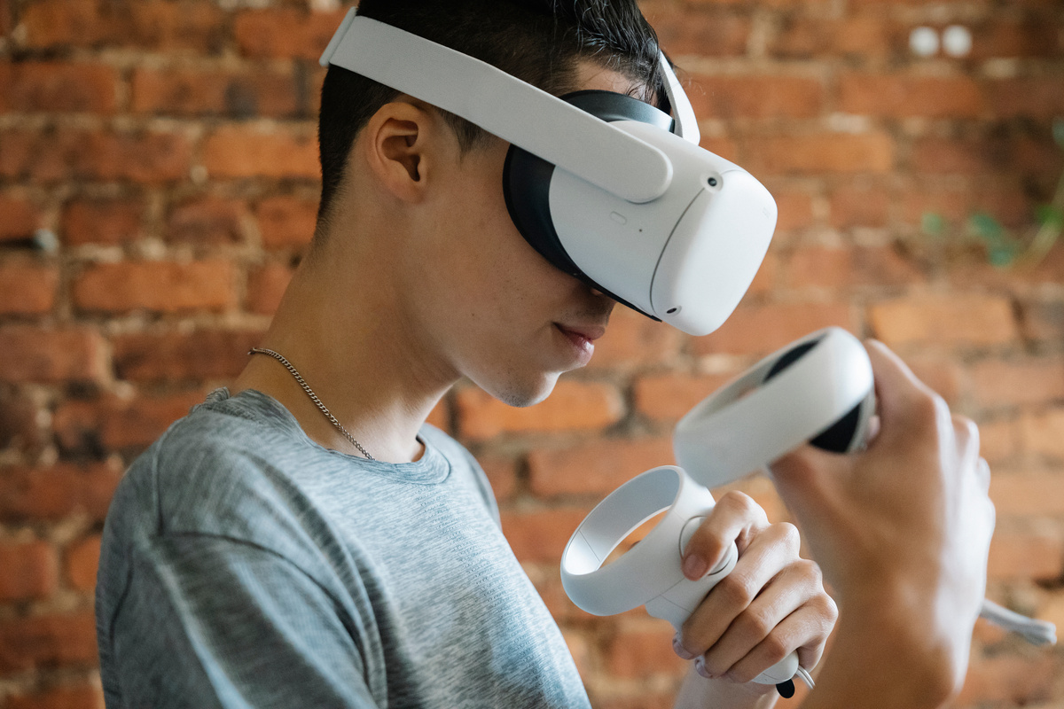
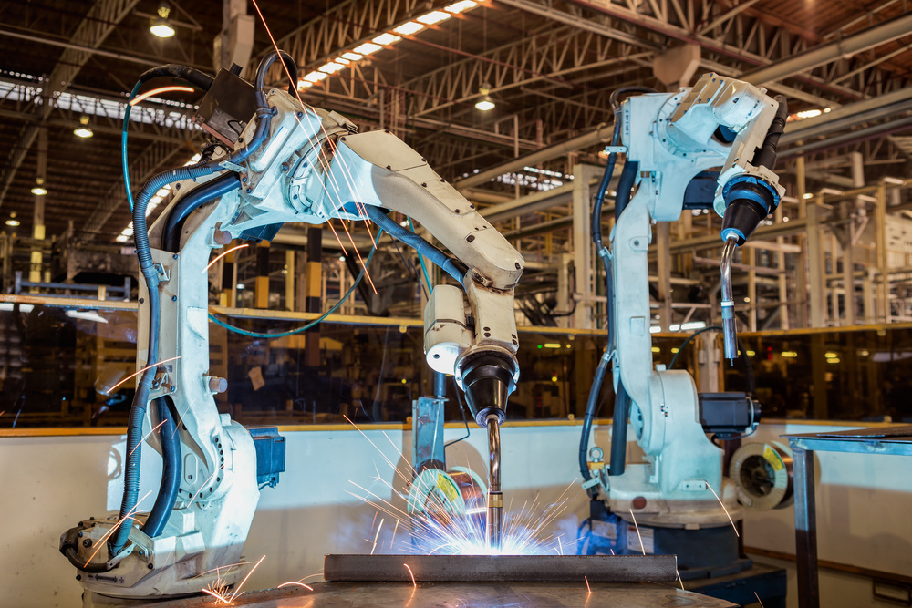
Problem Statement
Developing an AR/VR tool which can be used to enhance industrial robotics.
A digital twin of the robot is made and simulated to run on an AR/VR interface.
The physical robot functions the same way as the digital twin and thus the AR/VR tool can be used to control it.

Slide 4
Scope and Feasibility study
Scope:
Real-time monitoring and control of robotic systems
Predictive Remote maintenance, optimization and programming of operations
Virtual prototyping and training of robotic systems
Feasibility:
Advancements in sensor technology and data analytics
Development of powerful simulation and modelling software
Integration with Industry 4.0 and IoT platforms

Slide 5
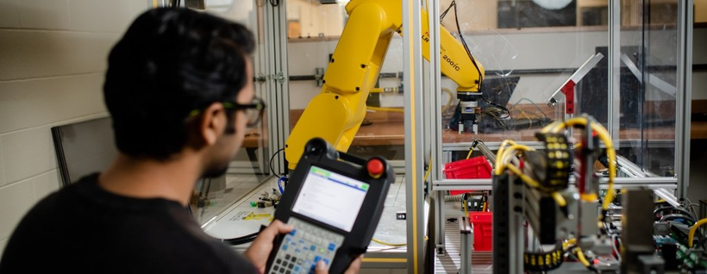
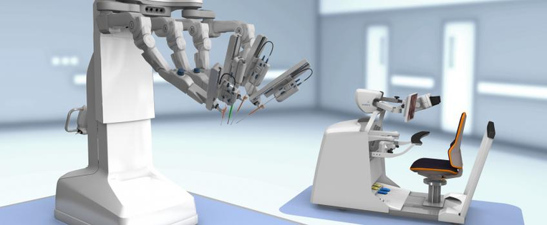
Applications/Use cases
Training and simulation: Virtualisation of the robot means we can simulate scenarios and conditions on the robot and train its behaviour.
Remote control and programming: The digital twin can be programmed and controlled virtually, which will reflect its real world movements, and can be done remotely
Monitoring: The digital twin receives data from the robot which allows for accurate real time monitoring.

Slide 6
Expected Deliverables
Building a digital twin which can be operated completely remotely with the virtual twin mimicking the real robot with a high level of accuracy.
AR/VR platform to view and manipulate the digital twin for Human Robot Collaboration
Run a training model on the digital twin which will reflect on the real world robot

Slide 7
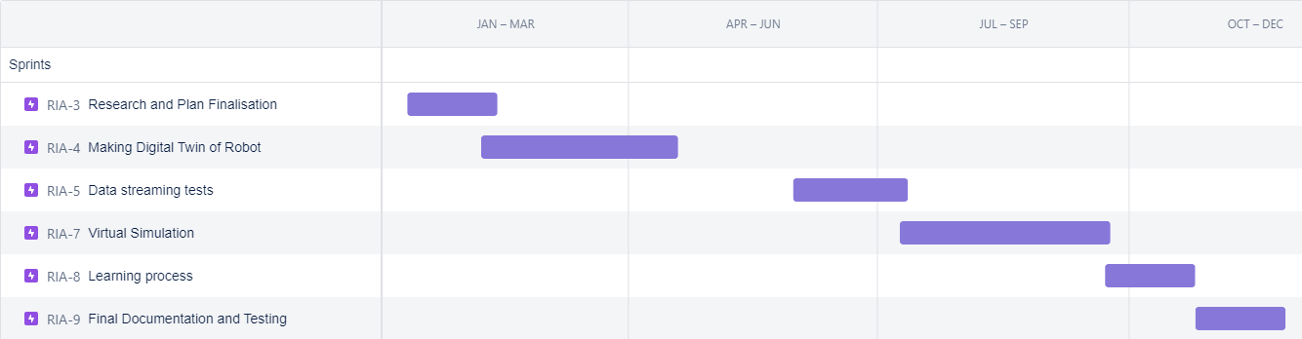
Capstone (Phase-I & Phase-II) Project Timeline
6th semester: Literature surveys, research, academic paper writing, laying groundwork for the interface and complete digital twin.
7th semester: Complete digital twin, virtual simulation, data streaming, training the digital twin, thesis publication.

Slide 8
Any other information
Tools and processes:
3D modeling - blender, Unity3D
AR platform - Industrial AR tools
Robotics- Raspberry pi, ArduinoIDE, ROS
Languages- C++, C#, python.
Research done -
https://docs.google.com/spreadsheets/d/1Uet7KWej06JfQ50rUx7eLIetOz4LF18dSRvonRCbmfc/edit#gid=0

Slide 9
Thank You

